Slide 1
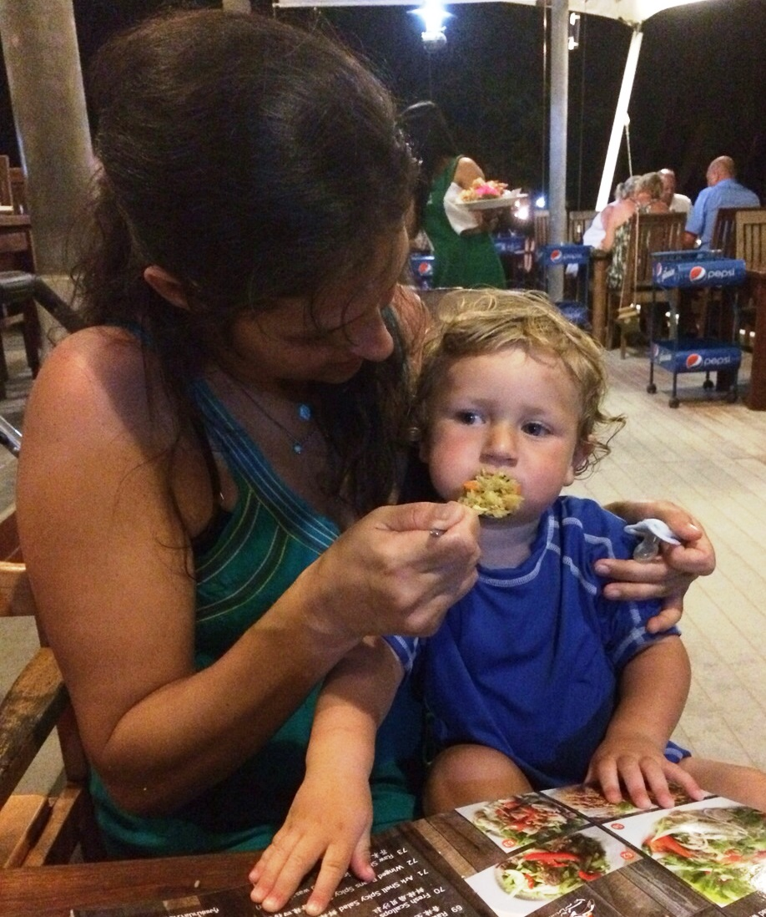
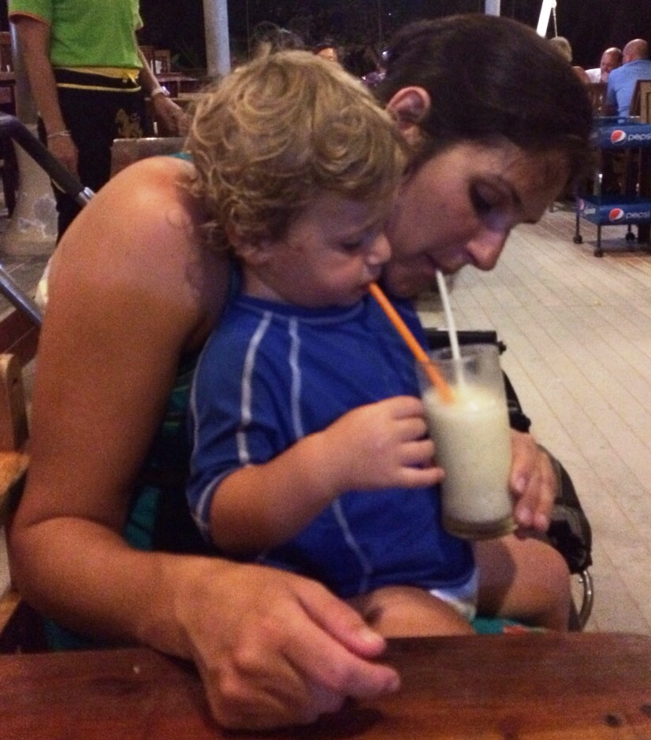
Eat my child, eat! Mother's postpartum change in attachment and body image
The 2015 Obesity Summit
Lev-Ari, L.¹, Bachner-Melman, R.^{1, 2}, Zohar A.H.¹, Ebstein R.P.³, & Mankuta D.⁴
Social and Community Sciences, Ruppin Academic Center,
Emek Hefer, Israel
2. Psychology, Hebrew University of Jerusalem, Israel
3. Psychology, National University of Singapore, Singapore
4. Obstetrics and Gynecology, Hadassah Medical Center
Background and Goals: Pregnancy and birth are major events in a woman’s life. Weight changes may impact body image, and relating to the newborn may influence the mother's attachment configuration. This study aimed to examine whether maternal attachment style and body image indices change during the year following birth and to explore links between them.
Hypotheses:
Methods: Participants in the study were 195 mothers who gave birth at a hospital in Israel between 2008 and 2012. The BMI of mothers and their babies were measured and recorded within 2 days after birth (Time 1). Mothers reported their own and their babies’ height and weight one year postpartum (Time 2) and completed self-report measures of attachment style, body image, eating attitudes and feeding practices.
Results: We used cluster analysis, a person-focused approach describing individual differences and the links between different experiences of the same individuals, entering mother’s attachment styles (avoidant and anxious-ambivalent attachment) at Time 1 and Time 2 to identify groups of mothers with common attachment characteristics. We then used repeated measures to examine differences in BMI, body image, eating attitudes and breastfeeding habits across the three resulting groups: 1. Secure-stable attachment - mothers with low scores on both insecure attachment dimensions at both points in time; 2. Insecure-improved attachment - mothers with high scores on both insecure attachment dimensions at Time 1 but significantly lower scores at Time 2; and 3. Insecure-worsened attachment - mothers tending to have high scores on both insecure attachment dimensions at Time 1 and who scored even higher at Time 2. Level of education was entered as a covariate in the analyses, since it was lower in the insecure-worsened group than the other groups. Eating attitudes were healthiest in secure-stable mothers at both measurement times, and deteriorated over the year for Insecure-unstable mothers. Secure-unstable mothers were least satisfied with their bodies at both measurement times, and Secure-stable mothers were less aware than the other groups of the thin female ideal. Interestingly, despite an average weight loss of 6.06 kg, all mothers became less satisfied with their bodies over the year. Although there were no between-group differences between the babies’ BMI at time 1, significant interaction between group and time was observed, with the BMI of Insecure-unstable mothers’ babies increasing significantly more than that of the other groups during their first year of life. No differences between mothers' BMI or frequency of breastfeeding were found across group or time.
Table 1
Cluster analysis: Means of mother's attachment styles times 1 and 2
Table 2
Repeated measures testing the differences between the different clusters on BMI,
body dissatisfaction, eating attitudes and baby's BMI
 | Cluster 1 Secure-stable N=57 | Cluster 2 Insecure-worsened N=72 | Cluster 3 Insecure-improved N=66 | F_{(2,192)}
Anxious-ambivalent Time 1 | 2.47 | 2.43 | 4.01 | 131.73***
Avoidant Time 1 | 2.87 | 2.99 | 3.77 | 24.11***
Anxious-ambivalent Time 2 | 2.22 | 3.99 | 3.53 | 129.51***
Avoidant Time 2 | 2.75 | 3.91 | 3.61 | 63.14***
 | Main effect for cluster | Main effect for time | Interaction between cluster and time
BMI | NS | NS | NS
Eating attitudes | F_{(2,99)}=8.23*** | NS | NS
Body dissatisfaction | F_{(2,100)} =3.25* | NS | NS
Baby's BMI | F_{(2,74)} =9.29*** | F_{(1,74)} =3.76* | F_{(2,74)} =9.42***
Figure 1. Eating attitudes at times 1 and 2 by mother's attachment cluster
Figure 2. Body dissatisfaction at times 1 and 2 by mother's attachment cluster
Figure 3. Baby's BMI at times 1 and 2 by mother's attachment cluster
Conclusion: Rather than approaching attachment style as a constant, this study takes into account how giving birth impacts maternal attachment style, and reveals links between attachment style, eating attitudes and body image during the year after giving birth. Results highlight a subgroup of mothers with insecure attachment style and negative body image immediately after giving birth, who are even more insecurely attached and more disturbed in their eating habits when their babies are one year old. Their babies also seem to gain a disproportional amount of weight during this year. The combination of insecure attachment and disturbed eating attitudes in mothers at the time of birth may predict a tendency in their children to become overweight and prove useful in interventions aimed at preventing childhood obesity.
Notes:
Subconscious comparison
Conscious comparison
To mom
To best friend
To sister
To self ideal
To mom
.81***
.49***
.48***
.48***
To best friend
.43***
.46***
.80***
.46***
To sister
.56***
.80***
.55***
.72***

